Slide 1
Chapter 2 part 2
STAT441

Slide 2


Numerical Methods for Describing Quantitative Data
The measures that we will present fall into three categories:
(1) those that help to locate the center of the relative frequency distribution,
(2) those that measure its spread around the center, and
(3) those that describe the relative position of an observation within the data set.

Slide 3
Numerical Methods for Describing Quantitative Data
These categories are called
measures of central tendency,
measures of variation
measures of relative standing.
We will denote the variable observed to create a data set by the symbol y and the n measurements of a data set by y1, y2, …, yn.

Slide 4
Numerical descriptive measure
A statistic is a numerical descriptive measure computed from sample data.
A parameter is a numerical descriptive measure of a population.
(Parameter values are typically unknown and are usually represented by Greek symbols)

Slide 5

Measures of Central Tendency
The three most common measures of central tendency are
the arithmetic mean,
the median,
the mode

Slide 6
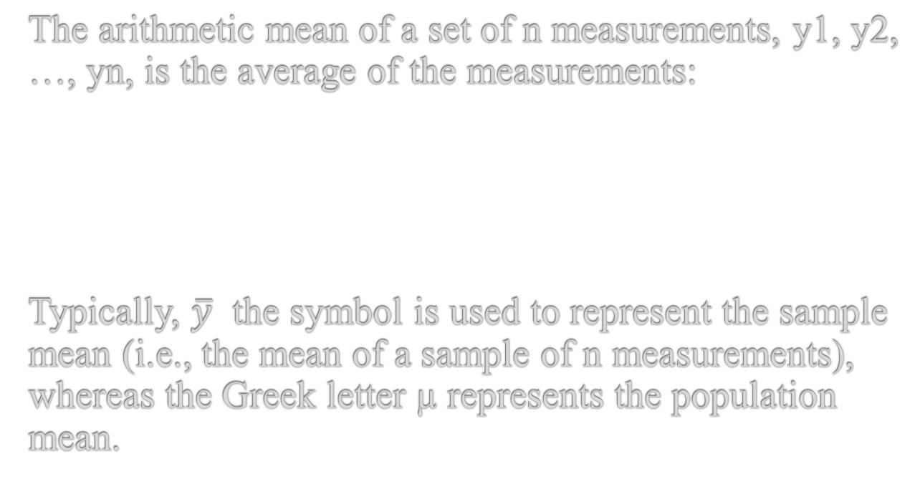
The arithmetic mean
The arithmetic mean of a set of n measurements, y1, y2, …, yn, is the average of the measurements:
Typically, $\overline{y}$ the symbol is used to represent the sample mean (i.e., the mean of a sample of n measurements), whereas the Greek letter µ represents the population mean.

Slide 7

To illustrate, we will calculate the mean for the set of n = 5 sample measurements: 4, 6, 1, 2, 3.

Slide 8
Measures of central tendency– Sample Median
The median of a set of n measurements, y1, y2, …, yn, is the middle number when the measurements are arranged in ascending (or descending) order, i.e., the value of y located so that half the area under the relative frequency histogram lies to its left and half the area lies to its right. We will use the symbol m to represent the sample median and the symbol τ to represent the population median.

Slide 9

Calculating the Median of Small Sample Data Sets
Let y(i) denote the ith value of y when the sample of n measurements is arranged in ascending order. Then the sample median is calculated as follows:

Slide 10

For example, the median of the n = 6 measurements, 1, 4, 5, 8, 10, 11, is

Slide 11
Measures of central tendency – Sample Mode
The mode of a set of n measurements, y1, y2, …, yn, is the value of y that occurs with the greatest frequency.

Slide 12
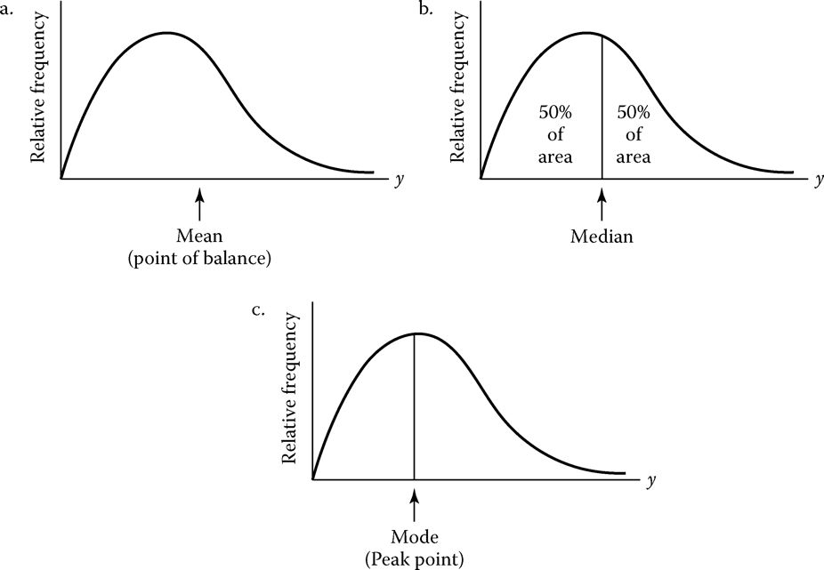
Interpretations of the mean, median, and mode for a relative frequency distribution

Slide 14
Mean-properties
Although the mean is often the preferred measure of central tendency, it is sensitive to very large or very small observations. Consequently, the mean will shift toward the direction of skewness (i.e., the tail of the distribution) and may be misleading in some situations.
For example, if a data set consists of the first-year starting salaries of civil engineering graduates, the high starting salaries of a few graduates will influence the mean more than the median.

Slide 15
Median- properties
The median is sometimes called a resistant measure of central tendency, since it, unlike the mean, is resistant to the influence of extreme observations.
For data sets that are extremely skewed, (e.g., the starting salaries of civil engineering graduates), the median would better represent the “center” of the distribution data.

Slide 16
Mode
The mode is preferred over the mean or median only if the relative frequency of occurrence of y is of interest. For example, a supplier of carpenter's materials would be interested in the modal length (in inches) of nails he sells.

Slide 17
Example
Seismologists use the “aftershock” to describe the smaller earthquakes that follow a main earthquake. Following the Northridge earthquake in 1994, the Los Angeles area experienced 2,929 aftershocks in a three-week period. The magnitudes (measured on the Richter scale) of these aftershocks as well as their inter-arrival times (in minutes) were recorded by the U.S. Geological Survey.

Slide 18
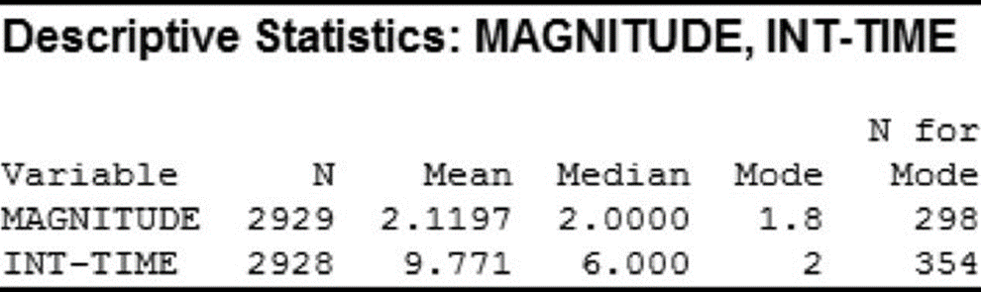
Example
Calculate and interpret the mean, median, and mode for both of these variables.

Slide 19

Measures of center
Which measure of central tendency is better for describing the magnitude distribution? The distribution of inter-arrival times?

Slide 20
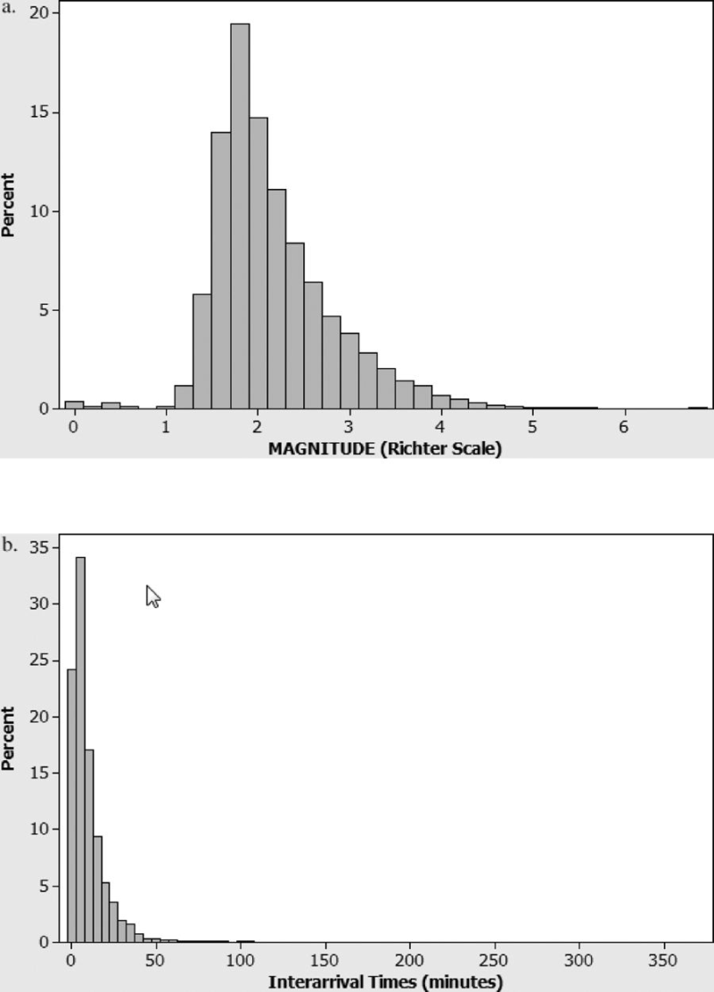
Histograms

Slide 21
Summary of magnitude of aftershocks
For magnitude, the mean, median, and mode are 2.12, 2.00, and 1.8, respectively, on the Richter scale. The average magnitude is 2.12; half the magnitudes fall below 2.0; and, the most commonly occurring magnitude is 1.8.

Slide 22
Summary of magnitude of aftershocks
These values are nearly identical, with the mean slightly larger than the median. This implies a slight rightward skewness in the data.
Because the distribution is nearly symmetric, any of the three measures would be adequate for describing the “center” of the earthquake aftershock magnitude distribution.

Slide 23
Summary of inter arrival times
The mean, median, and mode of the inter-arrival times of the aftershocks are 9.77, 6.0, and 2.0 minutes, respectively.
On average, the aftershocks arrive 9.77 minutes apart; half the aftershocks have inter-arrival times below 6.0 minutes; and, the most commonly occurring inter-arrival time is 2.0 minutes.

Slide 24
Summary of inter arrival times
The mean is much larger than the median, implying that the distribution of inter-arrival times is highly skewed to the right.
This extreme rightward skewness is shown graphically in the histogram,

